Slide 1
Unit 1—Lesson 2:
Constants, Variables, and Data Types
Notes:
Say
Swift safety includes a way to specify with precision if something is constant or if it can vary over time.

Slide 2
Constants and variables
Associate a name with a value
Defining a constant or variable
Allocates storage for the value in memory
Associate the constant name with the assigned value

Slide 3
Constants
Defined using the let keyword
let name = “John”
Defined using the let keyword
let pi = 3.14159
Can’t assign a constant a new value
let name = “John”
name = “James”
!
Cannot assign to value: ‘name’ is a ‘let’ constant

Slide 4
Variables
Defined using the var keyword
var age = 29
Can assign a new value to a variable
var age = 29
age = 30

Slide 5
let defaultScore = 100
var playerOneScore = defaultScore
var playerTwoScore = defaultScore
print(playerOneScore)
print(playerTwoScore)
playerOneScore = 200
print(playerOneScore)
100
100
200
Notes:
Note
This is an example of assigning a constant to a variable and modifying a variable.

Slide 6
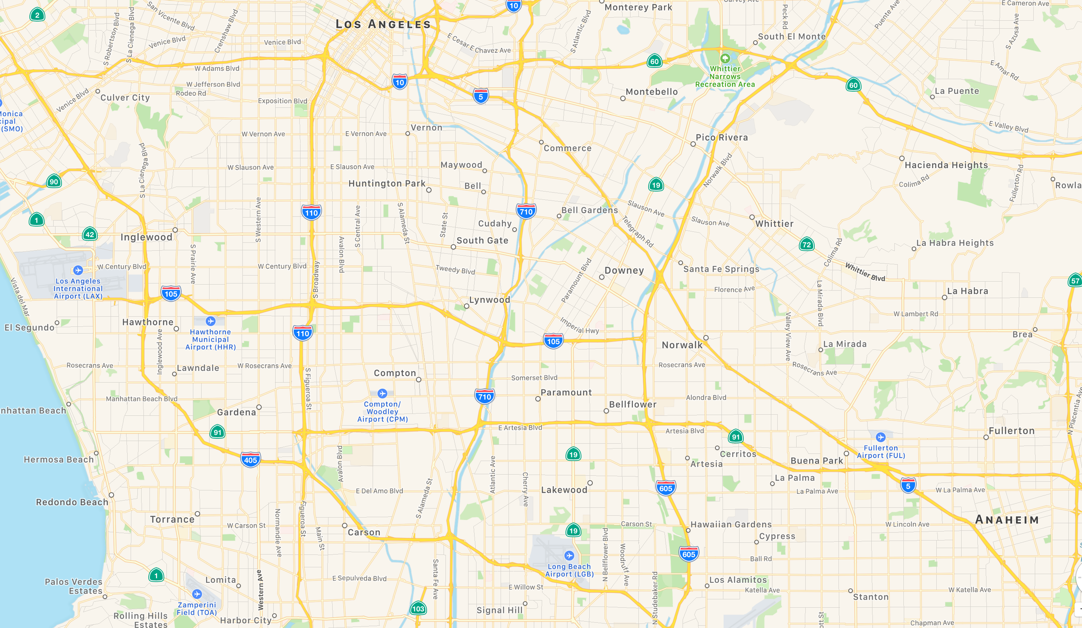
Constant or variable?
Starting location
Current location
Distance traveled
Remaining distance
Destination
Footnote here. If there is no footnote, delete this text box.
Notes:
Say
Use a constant when a value won’t change during the lifetime of a single execution of the code.
Consider an app for calculating distances traveled on a trip (it tracks one trip per execution of code).
Do
Ask if the following is a constant or variable (Click to display each):
Starting location (constant)
Destination (constant)
Current location (variable)
Distance traveled (variable)
Remaining distance (variable)
Explain the reasons for using constants: safety, efficiency, idiomatic.

Slide 7
Naming constants and variables
Rules
No mathematical symbols
No spaces
Can’t begin with a number
let π = 3.14159
let 一百 = 100
let 🎲 = 6
let mañana = "Tomorrow"
let anzahlDerBücher = 15 //numberOfBooks
Notes:
Say
Unicode, including emoji symbols, make code easier for non-English text.

Slide 8
Naming constants and variables
Best practices
Be clear and descriptive
Use camel case when multiple words in a name
⨯
n
✓
firstName
⨯
firstname
✓
firstName
Notes:
Do
Click to display No/Yes for clear and descriptive names.
Click to display No/Yes for for camel case: “firstname" and “firstName.”

Slide 9
Comments
// Setting pi to a rough estimate
let π = 3.14
/* The digits of pi are infinite,
so instead I chose a close approximation.*/
let π = 3.14
Notes:
Do
Explain the two commenting methods.

Slide 10
Types
struct Person {
let firstName: String
let lastName: String
func sayHello() {
print("Hello there! My name is \(firstName) \(lastName).")
}
}
Notes:
Say
Swift uses “type” to mean a grouping of properties and functions. We'll see that Swift has fewer differences between classes and nonclasses than some other languages.
Types can have data and behavior—properties and methods.
Note some of the keywords: struct, let, and func.
We'll cover these as we go through the course.

Slide 11
struct Person {
let firstName: String
let lastName: String
func sayHello() {
print("Hello there! My name is \(firstName) \(lastName).")
}
}
let aPerson = Person(firstName: "Jacob", lastName: "Edwards")
let anotherPerson = Person(firstName: "Candace", lastName: "Salinas")
aPerson.sayHello()
anotherPerson.sayHello()
Hello there! My name is Jacob Edwards.
Hello there! My name is Candace Salinas.
Notes:
Note
This code sample shows a Person type, creating some instances and calling some methods.
Again, these things will be described in detail as we go along.

Slide 12
Most common types
 | Symbol | Purpose | Example
Integer | Int | Represents whole numbers | 4
Double | Double | Represents numbers requiring decimal points | 13.45
Boolean | Bool | Represents true or false values | true
String | String | Represents text | “Once upon a time…”
Notes:
Note
This code sample shows a Person type, creating some instances and calling some methods.
Again, these things will be described in detail as we go along.

Slide 13
Type safety
let playerName = "Julian"
var playerScore = 1000
var gameOver = false
playerScore = playerName
var wholeNumber = 30
var numberWithDecimals = 17.5
wholeNumber = numberWithDecimals
!
Cannot assign value of type ‘String’ to type ‘Int’
!
Cannot assign value of type ‘Double’ to type ‘Int’
Notes:
Do
Click to display first error: Cannot assign value of type ‘String’ to type ‘Int’
Click to display second error: Cannot assign value of type ‘Double’ to type ‘Int’
Say
The safety here is no unintended truncation.

Slide 14
Type inference
let cityName = "San Francisco"
let pi = 3.1415927
Notes:
Say
When it's not ambiguous, Swift can infer the type.
What's the type of ‘cityName’? (String)
What’s the type of ‘pi’? (Double)

Slide 15
Type annotation
let cityName: String = "San Francisco"
let pi: Double = 3.1415927
let number: Double = 3
print(number)
3.0
Notes:
Say
It's always OK to put in the type if you want to.
Next we'll see some cases where specifying the type is required.

Slide 16
Type annotation
Three common cases
When you create a constant or variable before assigning it a value
let firstName: String
//...
firstName = "Layne"

Slide 17
Type annotation
Three common cases
When you create a constant or variable that could be inferred as two or more different types
let middleInitial: Character = "J"
var remainingDistance: Float = 30
Notes:
Note
First code line: If not specified, middleInitial would be a String.
Second code line: If not specified, remainingDistance would be an Int.

Slide 18
Type annotation
Three common cases
When you add properties to a type definition
struct Car {
let make: String
let model: String
let year: Int
}

Slide 19
Required values
var x
!
Type annotation missing in pattern
Notes:
Do
Click to display the error: type annotation missing in pattern.

Slide 20
Required values
var x: Int

Slide 21
Required values
var x: Int
print(x)
!
Variable 'x' used before being initialized
Notes:
Do
Click to display the error: Variable 'x' used before being initialized.
Say
Another example of Swift safety: you must initialize variables or constants before you use them.

Slide 22
Required values
var x: Int
x = 10
print(x)
10
Notes:
Say
x is initialized before it’s printed, so all is fine now.

Slide 23
Number formatting
var largeUglyNumber = 1000000000
var largePrettyNumber = 1_000_000_000
Notes:
Do
Explain how underscore (_) can be used to format numbers within code.
It’s similar to comments in that it is ignored by the compiler.

Slide 24
Unit 1—Lesson 2
Lab - Constants and Variables.playground
Open and complete the exercises in Lab - Constants and Variables.playground

Slide 25
Notes:
L550025A-en_WW App Development with Swift © 2017 Apple Inc. This work is licensed by Apple Inc. under the Creative Commons Attribution-NonCommercial-ShareAlike 4.0 International license (https://creativecommons.org/licenses/by-nc-sa/4.0/legalcode).

